Slide 1
Zarra
8/5/2023
Report for July 2023

Slide 2
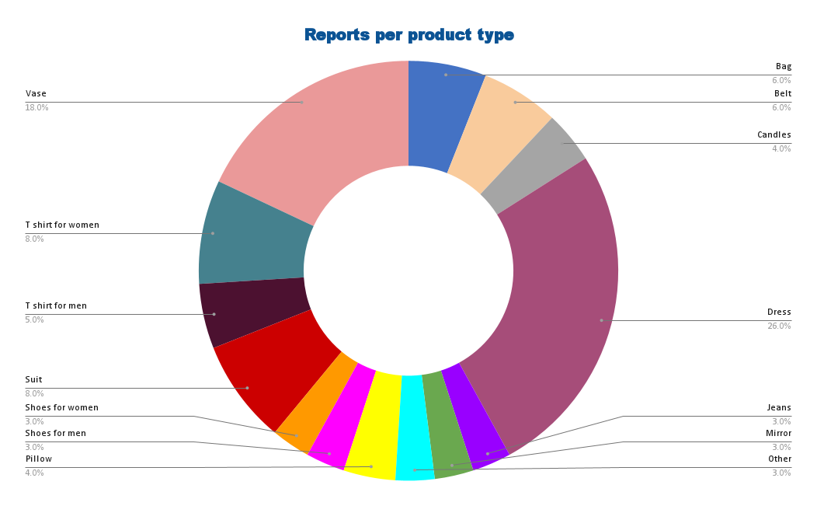
Zarra
Report for July 2023
Notes:
Reports per product type -> The highest percentage in whole: Dress, Vase

Slide 3
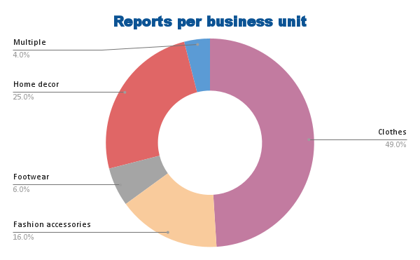
Zarra
Report for July 2023
Notes:
Reports per business unit -> The highest percentage in whole: Clothes, Home decor, Fashion accessories

Slide 4
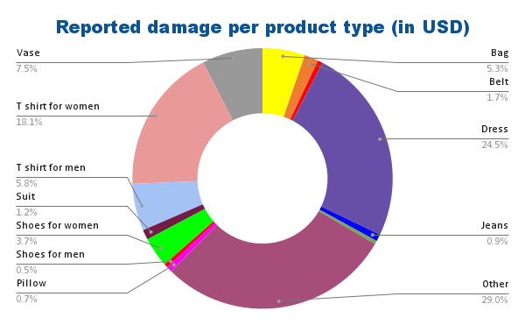
Zarra
Report for July 2023
Total reports: 100
Total damage: $363,000.00
Notes:
Reported total damage to assets (€) -> Since the most damage is caused by product type Other, further investigation of this type should be next step, in order to suppress these damages as a consequence
-> Next highest percentage in whole have type Dress and T shirt for women. Steps for prevention should be discussed and steps for suppressing, investigatigation and verification should be put into work

Slide 5
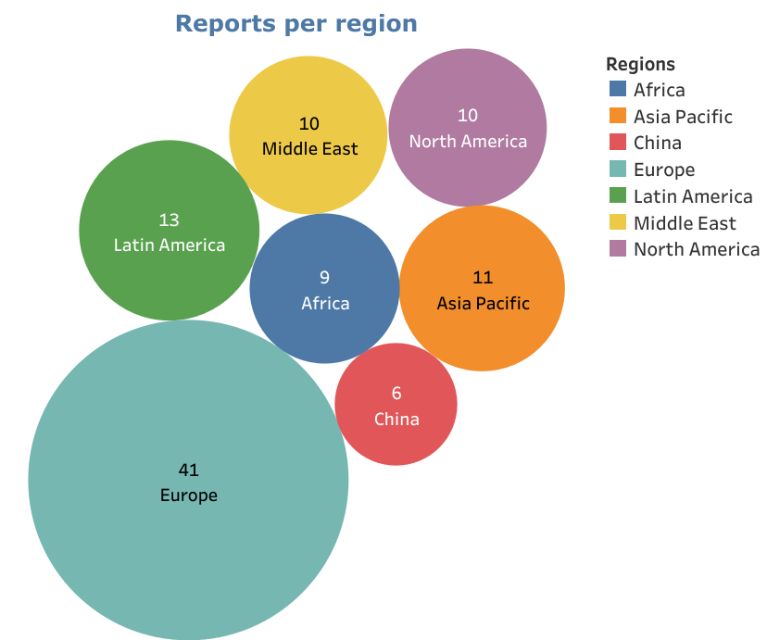
Zarra
Report for July 2023
Notes:
Reports per regions -> The highest percentage in whole: Europe

Slide 6
Zarra
Report for July 2023
Thank you for your attention

